Slide 1


Welcome to the Spektrix Patterns Group
Strategy Pattern

Slide 2
Agenda
To discuss and improve our understanding of design patterns. Initially we'll follow the 23 week guide covering the Gang of Four Design Patterns laid out by Joshua Kerievsky here - https://www.industriallogic.com/papers/learning.html
Although we'll introduce the Pattern with a code example at the start of the meeting, this is not designed to be a training session, it's intended to be a Study group to consider various questions about the pattern. In doing so we'll benefit from the wisdom of the crowd and hopefully improve our understanding.
Deep knowledge of patterns isn't required, and a diverse range of perspectives is encouraged, but it would be useful preparation if you have studied the pattern that'll be discussed before each session.
1 hour approximately
Demonstration of a problem that can be solved or avoided using the strategy pattern.
We will walk through the decision process and design process whixh leads to the Strategy Pattern emerging

Slide 3
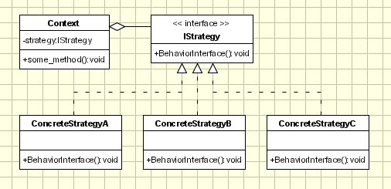
Strategy Pattern
“The Strategy Pattern defines a family of algorithms, encapsulates each one, and makes them interchangeable. Strategy lets the algorithm vary independently from clients that use it.” the Context class doesn't implement an algorithm directly.
Instead, Context refers to the Strategy interface for performing an algorithm (strategy.algorithm()), which makes Context independent of how an algorithm is implemented.
Notes:
Strategy is a Behavioural design pattern Iterator Template Method
Observer

Slide 4
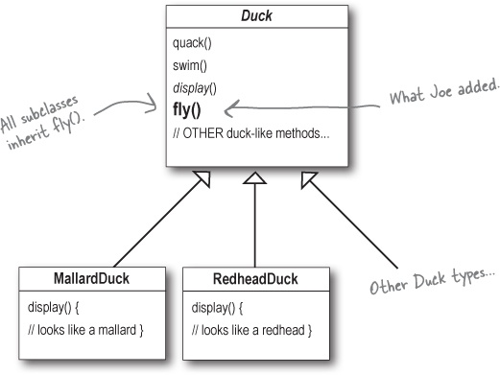
Duck Simulator Example
https://github.com/ronheywood/patternsgroup-strategy
https://www.oreilly.com/library/view/head-first-design/0596007124/ch01.html

Slide 5
Next Session
Let’s talk about… Decorator
Spektrix.PatternsGroup(
Spektrix.DevTalk()
)

